Slide 1



IPW Simulation 2
Department of Biostatistics and Bioinformatics,
Duke University
December 12, 2017

Slide 2
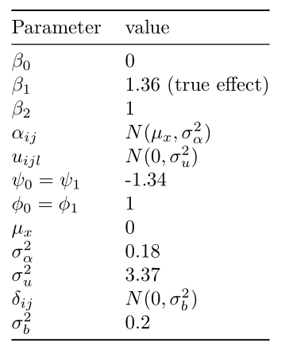
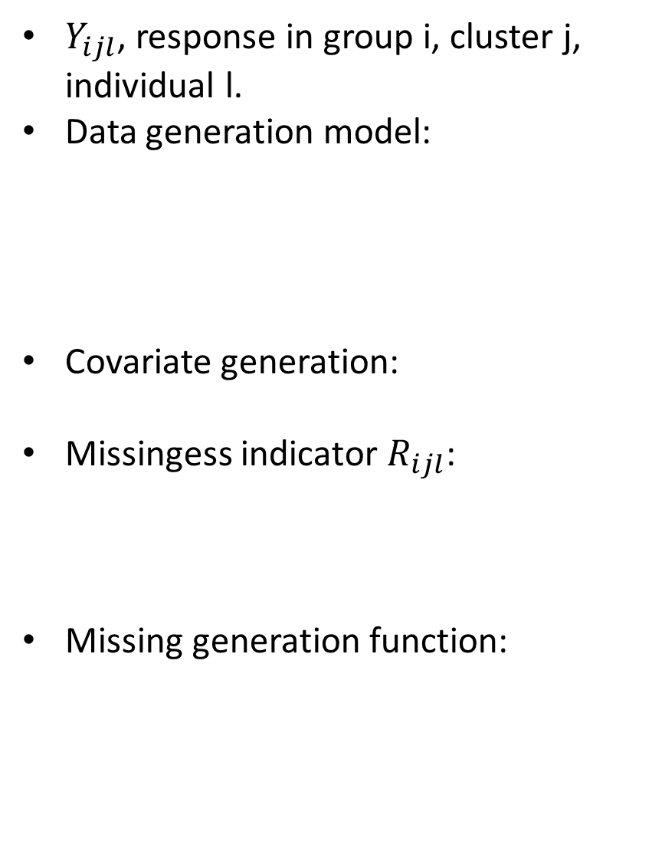

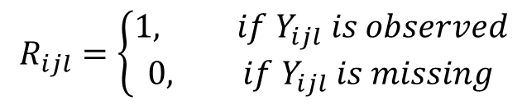




Previous Covariates values
$Y_{ijl}$, response in group i, cluster j, individual l.
Data generation model:
Covariate generation:
Missingess indicator $R_{ijl}$:
Missing generation function:
$$π_{ijl}=expip(β_{0}+β_{1}i+f_{i}\left(X_{ijl}\right)+δ_{ij})$$
$$f_{i}\left(X_{ijl}\right)=β_{2}X_{ijl}$$
$$Y_{ijl} ∼Bin(1,π_{ijl})$$
$$X_{ijl}=α_{ijl}+u_{ijl}$$
$$R_{ijl}=\left\{\begin{aligned}1, if Y_{ijl} is observed \\ 0, if Y_{ijl} is missing\end{aligned}\right.$$
${logit(R}_{ijl}=0|Y_{ijl, }X_{ijl}$)=$ψ_{i}+φ_{i}X_{ijl}$

Slide 3
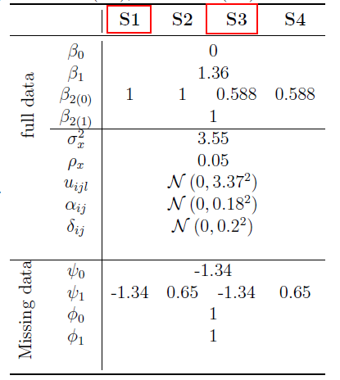

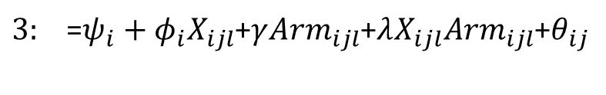
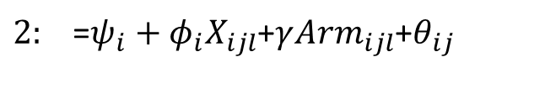
This time
Missing generation function:
$1: {logit(R}_{ijl}=0|Y_{ijl, }X_{ijl}$)=$ψ_{i}+φ_{i}X_{ijl}$+$θ_{ij}$
$2:$=$ψ_{i}+φ_{i}X_{ijl}$+$γ{Arm}_{ijl}$+$θ_{ij}$
$3:$=$ψ_{i}+φ_{i}X_{ijl}$+$γ{Arm}_{ijl}$+$λX_{ijl}{Arm}_{ijl}$+$θ_{ij}$
Considering CV:
M0=25, M~ UNI(20,30)
M0=50, M~UNI(40,60)
ICC:
Model ICC: 0.05
Missingness ICC: 0.1
Notes:
This time we consider more complex scenarios

Slide 4
Missingness Handling Methods
Complete Record Analysis
Unadjusted
Adjusted
Inverse Probability Weighting (IPW):
IPW with no cluster effect: lmer+geepack
IPW with no cluster effect: CRTgeeDR
IPW with cluster effect: lmer+geepack
IPW with cluster effect: CRTgeeDR
Multilevel Multiple Imputation (MMI)
$$\operatorname{logit}\left(π_{ijl}\right)=β_{0}^{∗}+β_{1}^{∗}ARM$$
$\operatorname{logit}\left(π_{ijl}\right)=β_{0}^{∗}+β_{1}^{∗}ARM$+$β_{2}^{∗}X_{ijl}$

Slide 5
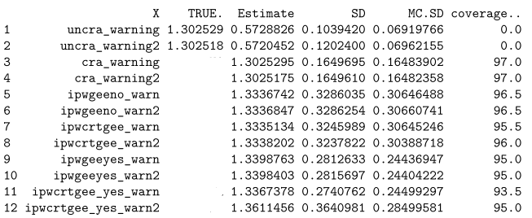

Scenario 1:
Missing generation function:
$1: {logit(R}_{ijl}=0|Y_{ijl, }X_{ijl}$)=$ψ_{i}+φ_{i}X_{ijl}$+$θ_{ij}$
Repeat 200 times
Parameters in S1
Notes:
4.1
Section 4.1

Slide 6
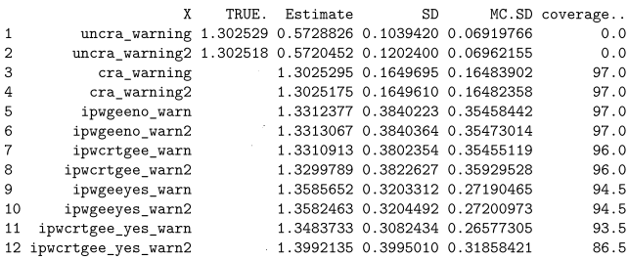
Scenario 2
Missing generation function:
$2: {logit(R}_{ijl}=0|Y_{ijl, }X_{ijl}$)=$ψ_{i}+φ_{i}X_{ijl}$+$X_{ijl}$+$γ{Arm}_{ijl}$+$θ_{ij}$
Repeat 200 times
Parameters in S1
Notes:
4.1
Section 4.1
General for，m
File in the value 用数字来代表 models
What is the distribution of x
How small and how large 95% x CI of x

Slide 7
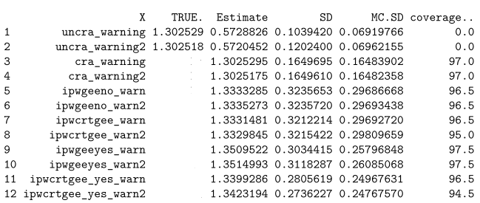
Scenario 3
Missing generation function:
$3: {logit(R}_{ijl}=0|Y_{ijl, }X_{ijl}$)=$ψ_{i}+φ_{i}X_{ijl}$+$X_{ijl}$+$γ{Arm}_{ijl}$+$λX_{ijl}{Arm}_{ijl}+θ_{ij}$
Repeat 200 times
Parameters in S1
Notes:
4.1
Section 4.1

Slide 8
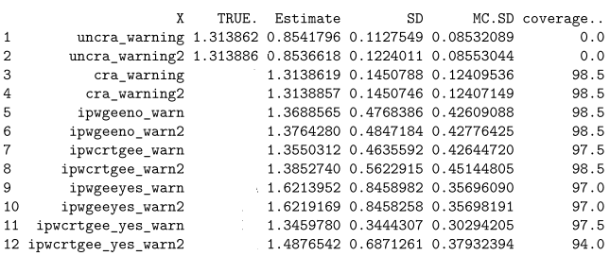

Scenario 4
Missing generation function:
$1: {logit(R}_{ijl}=0|Y_{ijl, }X_{ijl}$)=$ψ_{i}+φ_{i}X_{ijl}$+$θ_{ij}$
Repeat 200 times
Parameters in S2
Notes:
4.1
Section 4.1

Slide 9
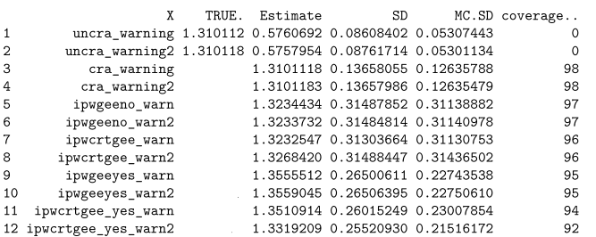
Scenario 5
Missing generation function:
$2: {logit(R}_{ijl}=0|Y_{ijl, }X_{ijl}$)=$ψ_{i}+φ_{i}X_{ijl}$+$X_{ijl}$+$γ{Arm}_{ijl}$+$θ_{ij}$
Repeat 200 times
Parameters in S2
Notes:
4.1
Section 4.1

Slide 10
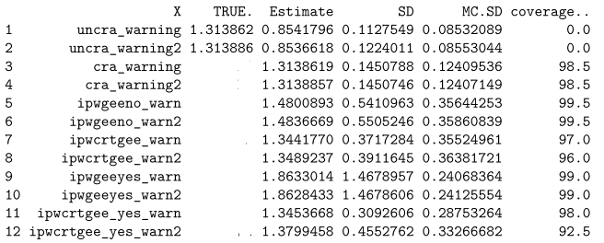
Scenario 6
Missing generation function:
$3: {logit(R}_{ijl}=0|Y_{ijl, }X_{ijl}$)=$ψ_{i}+φ_{i}X_{ijl}$+$X_{ijl}$+$γ{Arm}_{ijl}$+$λX_{ijl}{Arm}_{ijl}+θ_{ij}$
Repeat 200 times
Parameters in S2
Notes:
4.1
Section 4.1

Slide 11
Thank You!

